Slide 1
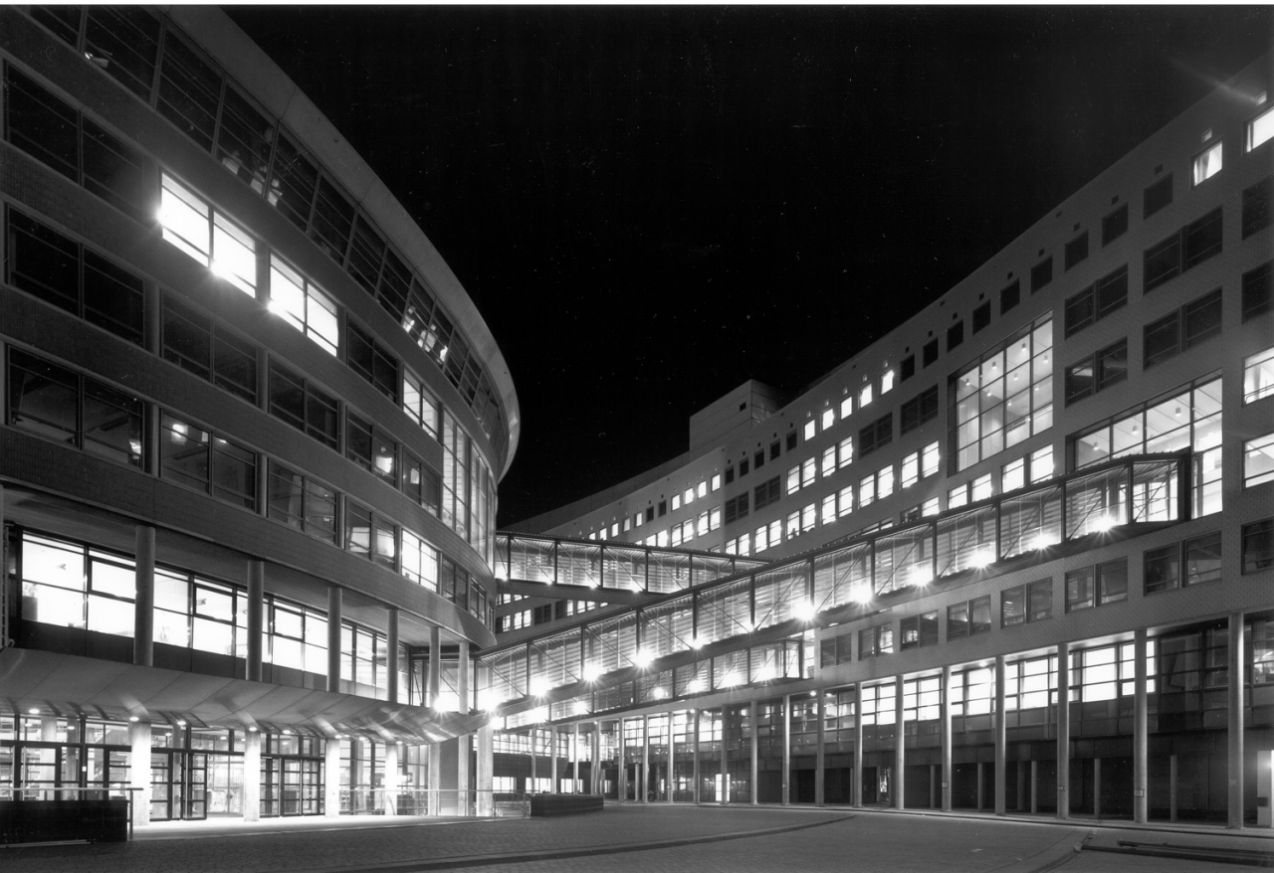


OPSCHALER
Progress Week 3
14-9-2018

Slide 2


Contents
Recap week 1
Clarify first research question
List and rate different energy prediction models
Planning week 2

Slide 3
Clarify first research question
Time period of prediction
Resolution of prediction
Using separate models for Gas and Electricity

Slide 4
List and rate energy prediction models
Regression
Fourier series
Neural networks

Slide 5
Planning week 2
7-9-2018

Slide 6




Planning
X61
Dataframe per house
Exploratory Data Analysis

Slide 7
Any questions?
7-9-2018

